Slide 1
Unit 3

Slide 2
Unit 3
Cascading Style Sheets (CSS-3): CSS Overview - CSS Rules, CSS Syntax and Style - Class Selectors, ID Selectors, span and div Elements - Cascading, style Attribute, style Container, External CSS Files –
CSS Properties: Color Properties, Font Properties, line-height Property, Text Properties, Border Properties. Element Box, padding Property, margin Property - Hosting a Website and GIT.

Slide 3
What is CSS?
CSS stands for Cascading Style Sheets
CSS describes how HTML elements are to be displayed on screen, paper, or in other media
CSS saves a lot of work. It can control the layout of multiple web pages all at once
External stylesheets are stored in CSS files

Slide 4
CSS can be added to HTML documents in 3 ways:
Inline - by using the style attribute inside HTML elements
Internal - by using a <style> element in the <head> section
External - by using a <link> element to link to an external CSS file

Slide 5
Inline CSS
An inline CSS is used to apply a unique style to a single HTML element.
An inline CSS uses the style attribute of an HTML element.
The following example sets the text color of the <h1> element to blue, and the text color of the <p> element to red:
Example
<h1 style="color:blue;">A Blue Heading</h1> <p style="color:red;">A red paragraph.</p>

Slide 6
h1 < style=“
display: block;
margin-top: 5cm;
margin-bottom: 0.67cm;
margin-left: 0;
margin-right: 0;
font-weight: bold; “
>

Slide 7
Inline CSS
<!DOCTYPE html> <html> <body> <h1 style="color:blue;text-align:center;">This is a heading</h1> <p style="color:red;">This is a paragraph.</p> </body> </html>

Slide 8
Internal CSS
<!DOCTYPE html> <html> <head> <style> body { background-color: linen; } h1 { color: maroon; margin-left: 40px; } </style> </head> <body> <h1>This is a heading</h1> <p>This is a paragraph.</p> </body>

Slide 9
External CSS
<!DOCTYPE html> <html> <head> <link rel="stylesheet" href="mystyle.css"> </head> <body> <h1>This is a heading</h1> <p>This is a paragraph.</p> </body> </html>

Slide 10
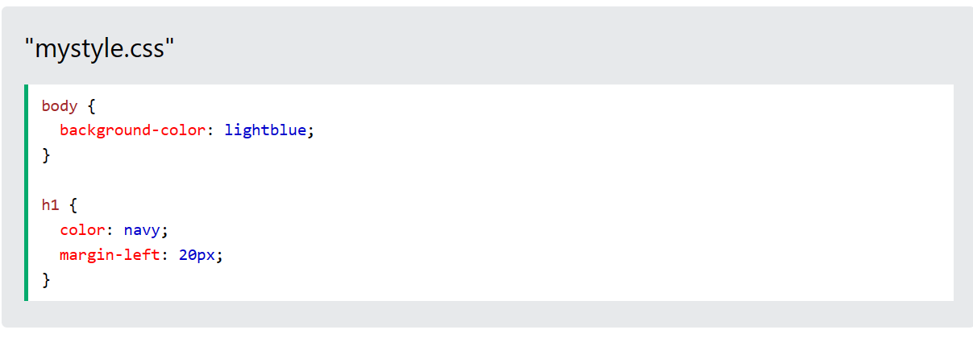

Slide 11

Cascading Order
What style will be used when there is more than one style specified for an HTML element?
All the styles in a page will "cascade" into a new "virtual" style sheet by the following rules, where number one has the highest priority:
Inline style (inside an HTML element)
External and internal style sheets (in the head section)
Browser default
So, an inline style has the highest priority, and will override external and internal styles and browser defaults.

Slide 12
CSS Comments
Comments are used to explain the code, and may help when you edit the sourc
/* This is a single-line comment */ p { color: red; }e code at a later date.

Slide 13
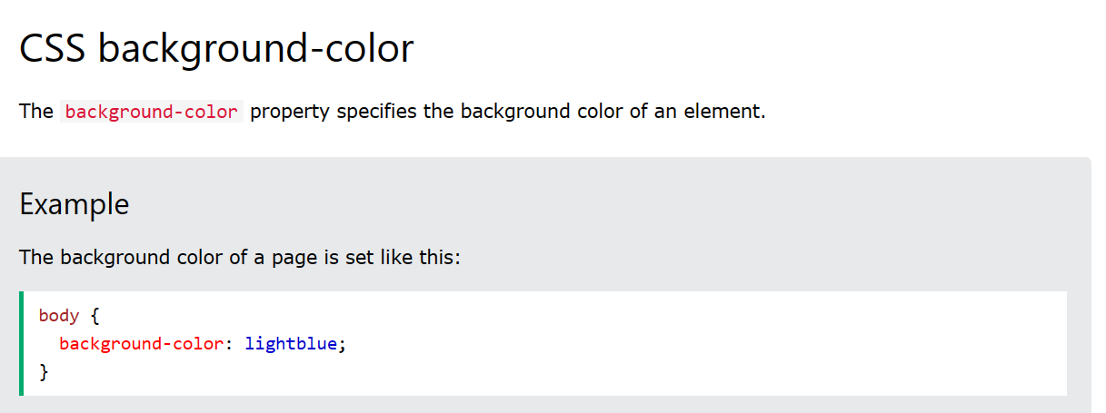

Slide 14
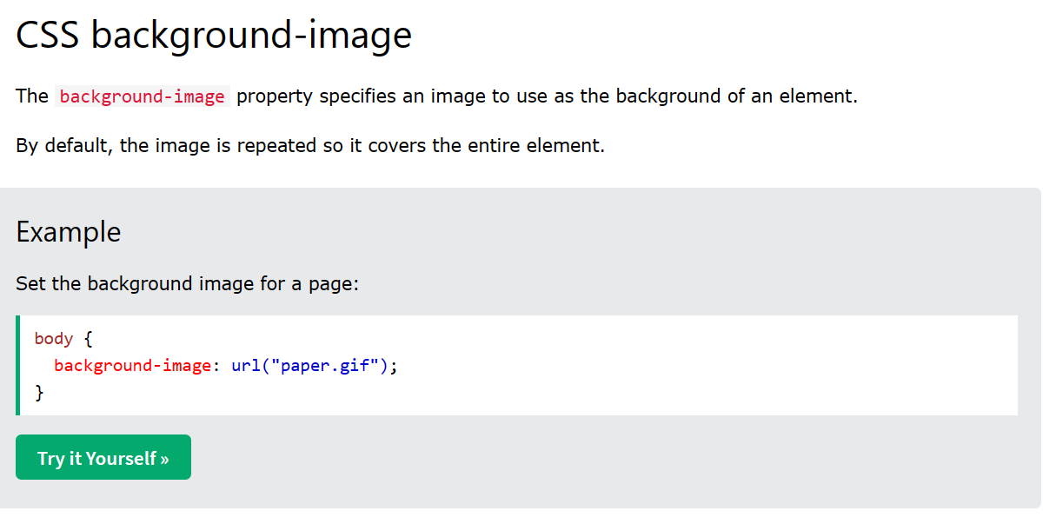

Slide 15
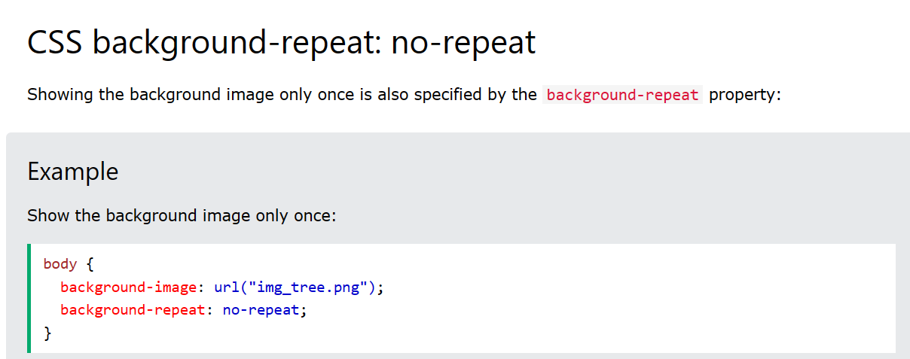

Slide 16
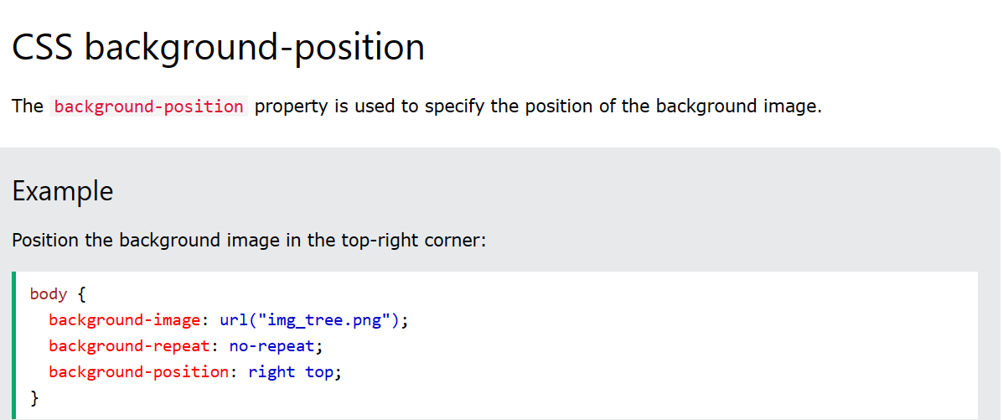

Slide 17
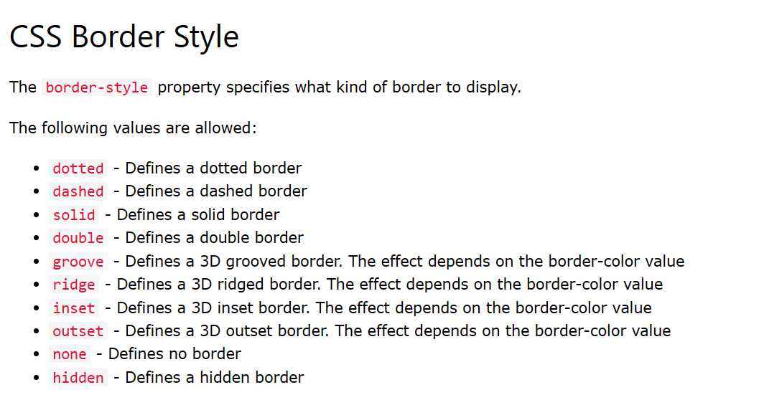

Slide 18
CSS Class Selector

Slide 19
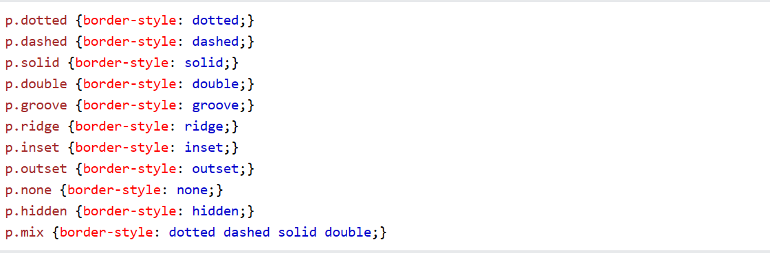

Slide 20
<!DOCTYPE html>
<html>
<head>
<style>
p.dotted {border-style: dotted;}
p.dashed {border-style: dashed;}
</style>
</head>
<body>
<h2>The border-style Property</h2>
<p>This property specifies what kind of border to display:</p>
<p class="dotted">A dotted border.</p>
<p class="dashed">A dashed border.</p>
</body>
</html>

Slide 21
<!DOCTYPE html>
<html>
<head>
<style>
h1.a{border-style: dotted;}
h1.b{border-style: dashed;}
h3.c{border-style: dashed;}
h3.d{border-style: dashed;}
h5.e{border-style: dashed;}
h5.f{border-style: dashed;}
</style>
</head>

Slide 22
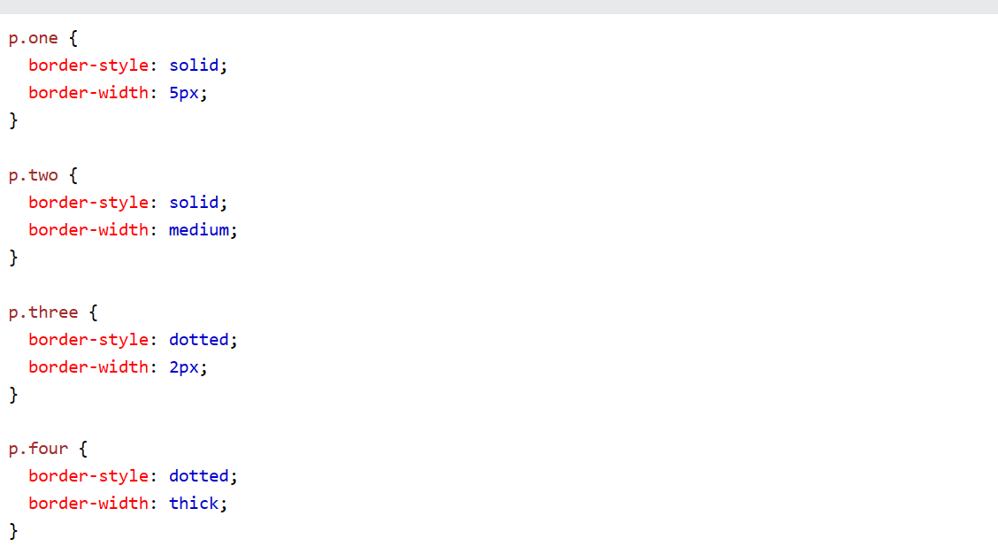

Slide 23
<!DOCTYPE html>
<html>
<head>
<style>
p.one {
border-style: solid;
border-width: 5px;
}
</style>
</head>
<body>
<h2>The border-width Property</h2>
<p>This property specifies the width of the four borders:</p>
<p class="one">Some text.</p>
<p><b>Note:</b> The "border-width" property does not work if it is used alone.
Always specify the "border-style" property to set the borders first.</p>
</body>
</html>

Slide 24
ID Selector

Slide 25
<!DOCTYPE html>
<html>
<head>
<style>
#para1 {
text-align: center;
color: red;
}
</style>
</head>
<body>
<p id="para1">Hello World!</p>
<p>This paragraph is not affected by the style.</p>
</body>
</html>

Slide 26
<!DOCTYPE html>
<html>
<head>
<style>
#header {
text-align: center;
color: red;
}
#footer {
text-align: center;
color: red;
}
#main {
text-align: center;
color: red;
}
</style>

Slide 27
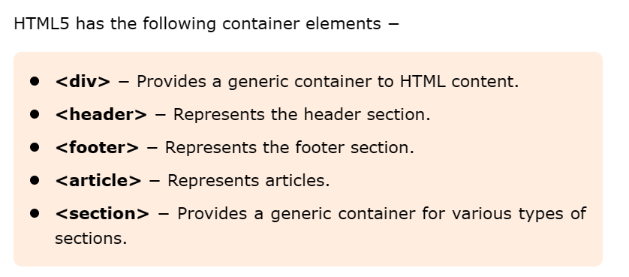

Slide 28
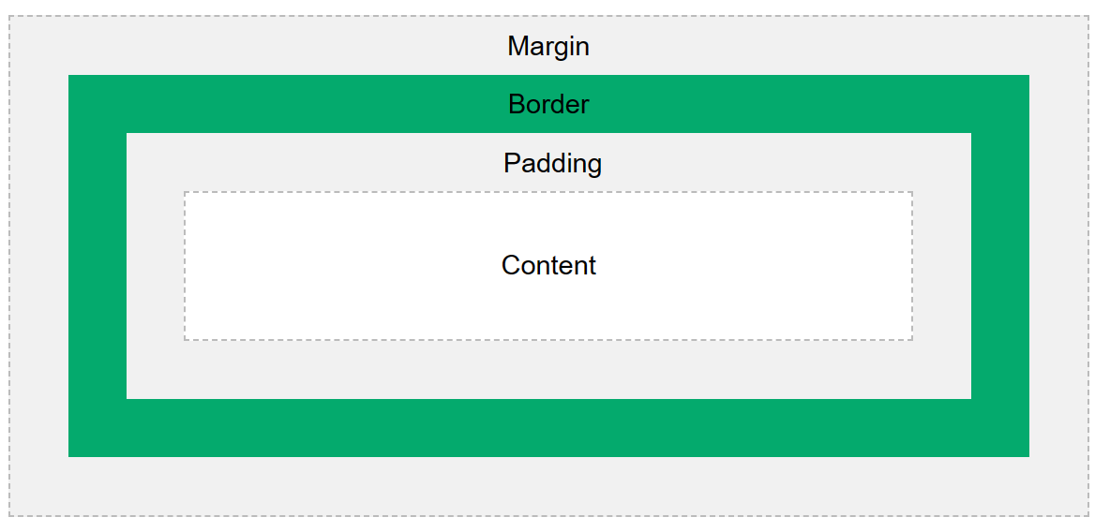

Slide 29


Slide 30
Color Properties
body { color: red; } h1 { color: #00ff00; } p.ex { color: rgb(0,0,255); }
Try it Yourself »

Slide 31
CSS font Property
p.a { font: 15px Arial, sans-serif; } p.b { font: italic small-caps bold 12px/30px Georgia, serif; }

Slide 32
<!DOCTYPE html>
<html>
<head>
<style>
p.a {
font: 15px Arial, sans-serif;
}
p.b {
font: italic small-caps bold 12px/30px Georgia, serif;
}
</style>
</head>
<body>
<h1>The font Property</h1>
<p class="a">This is a paragraph. The font size is set to 15 pixels, and the font family is Arial.</p>
<p class="b">This is a paragraph. The font is set to italic and bold, with small-caps (all lowercase letters are converted to uppercase). The font size is set to 12 pixels, the line height is set to 30 pixels, and the font family is Georgia.</p>
</body>
</html>

Slide 33
Font Variant
<!DOCTYPE html>
<html>
<body>
<h1>The font Property</h1>
<p style="font:caption">The font used in captioned controls.</p>
<p style="font:icon">The font used in icon labels.</p>
<p style="font:menu">The font used in dropdown menus.</p>
<p style="font:message-box">The font used in dialog boxes.</p>
<p style="font:small-caption">A smaller version of the caption font.</p>
<p style="font:status-bar">The font used in the status bar.</p>
<p><b>Note:</b> The result of the font keywords is browser dependant.</p>
</body>
</html>

Slide 34
The font-size Property

Slide 35
<!DOCTYPE html>
<html>
<head>
<style>
div.a {
font-size: 15px;
}
div.b {
font-size: large;
}
div.c {
font-size: 150%;
}
</style>
</head>
<body>
<h1>The font-size Property</h1>
<div class="a">This is some text.</div>
<div class="b">This is some text.</div>
<div class="c">This is some text.</div>
</body>
</html>

Slide 36
Line Height Property

Slide 37
<!DOCTYPE html>
<html>
<head>
<style>
div.a {
line-height: normal;
}
div.b {
line-height: 1.6;
}
div.c {
line-height: 80%;
}
div.d {
line-height: 200%;
}
</style>
</head>
<body>
<h1>The line-height Property</h1>
<h2>line-height: normal (default):</h2>
<div class="a">This is a paragraph with a standard line-height.<br>
The standard line height in most browsers is about 110% to 120%.</div>
<h2>line-height: 1.6 (recommended):</h2>
<div class="b">This is a paragraph with the recommended line-height.<br>
The line height is here set to 1.6. This is a unitless value;<br>
meaning that the line height will be relative to the font size.</div>
<h2>line-height: 80%:</h2>
<div class="c">This is a paragraph with a smaller line-height.<br>
The line height is here set to 80%.</div>
<h2>line-height: 200%:</h2>
<div class="d">This is a paragraph with a bigger line-height.<br>
The line height is here set to 200%.</div>
</body>
</html>

Slide 38
Text Properties

Slide 39
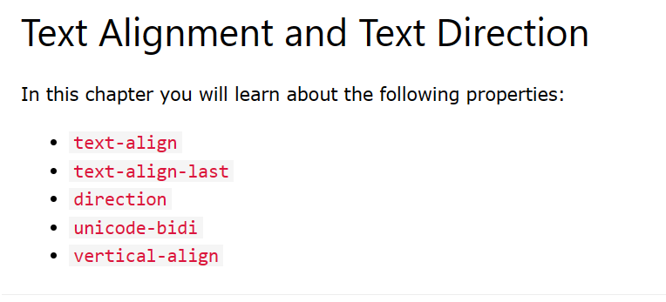

Slide 40
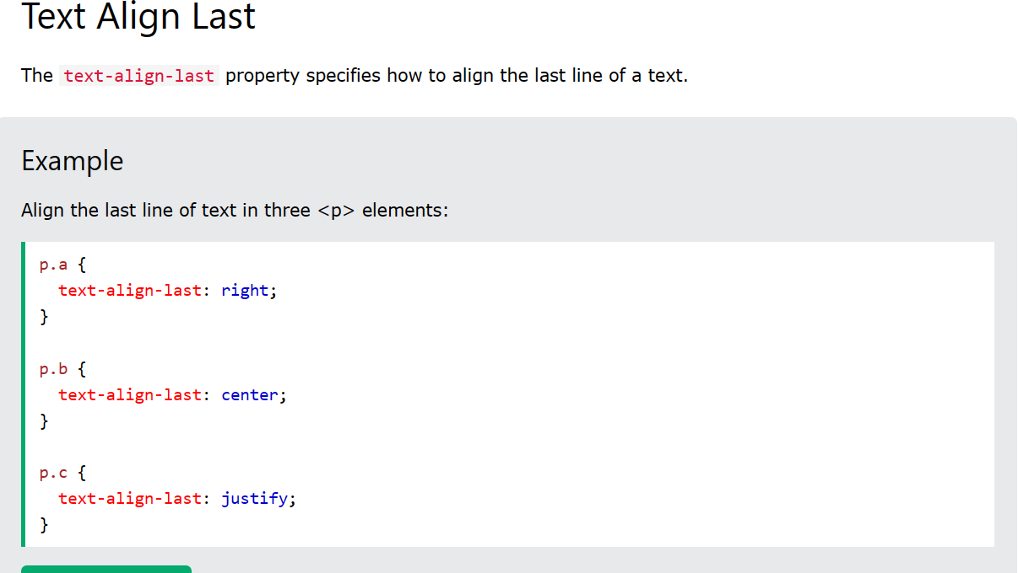

Slide 41
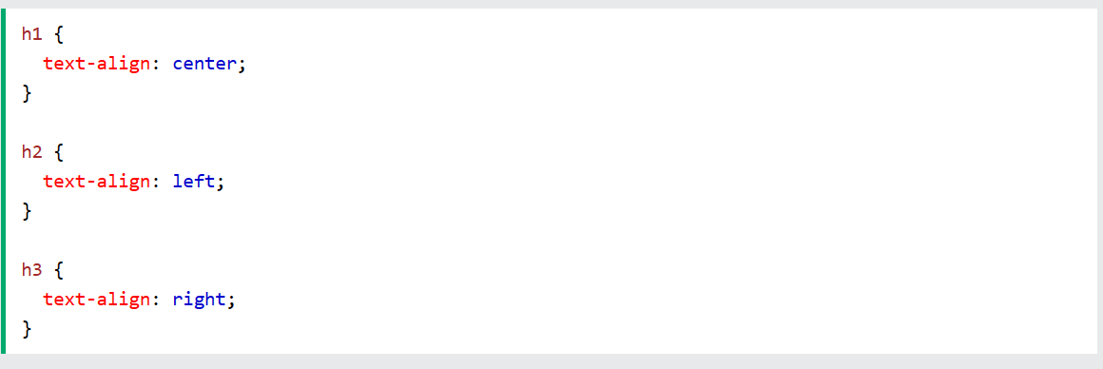

Slide 42
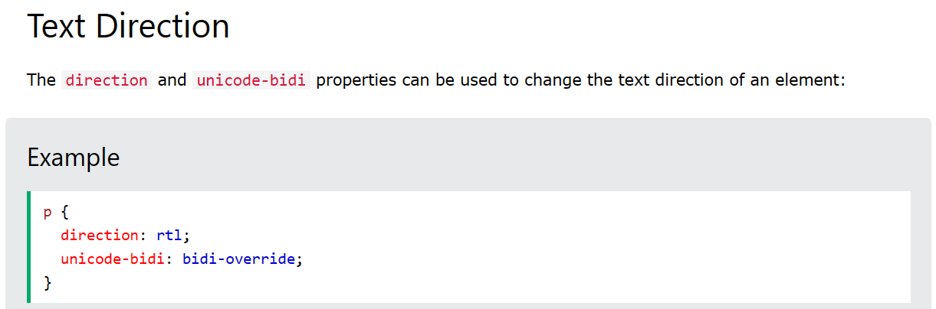

Slide 43
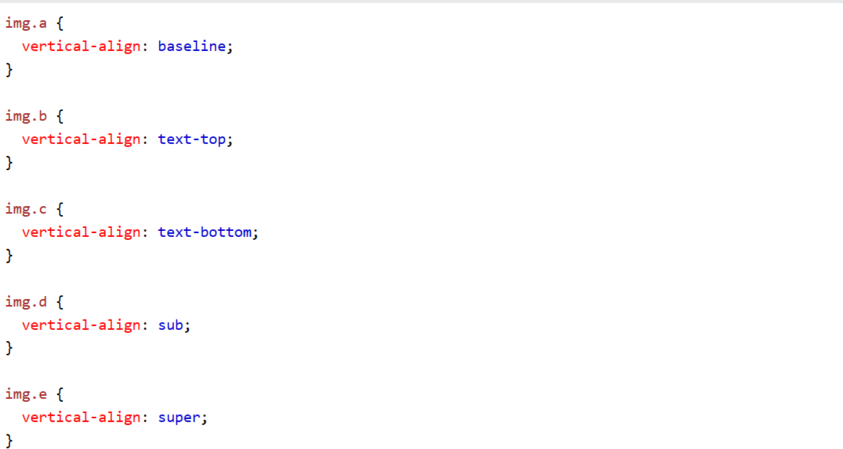

Slide 44
<!DOCTYPE html>
<html>
<head>
<style>
img.a {
vertical-align: baseline;
}
</style>
</head>

Slide 45
<h1>The vertical-align Property</h1>
<h2>vertical-align: baseline (default):</h2>
<p>An <img class="a" src="sqpurple.gif" width="9" height="9"> image with a default alignment.</p>
</body>
</html>

Slide 46
<!DOCTYPE html>
<html>
<head>
<style>
div {
border: 1px solid black;
background-color: lightblue;
padding-top: 50px;
padding-right: 30px;
padding-bottom: 50px;
padding-left: 80px;
}
</style>
</head>
<body>
<h2>Using individual padding properties</h2>
<div>This div element has a top padding of 50px, a right padding of 30px, a bottom padding of 50px, and a left padding of 80px.</div>
</body>
</html>

Slide 47
<!DOCTYPE html>
<html>
<head>
<style>
div {
margin: 70px;
border: 1px solid #4CAF50;
}
</style>
</head>
<body>
<h2>CSS Margins</h2>
<div>This element has a margin of 70px.</div>
</body>
</html>

Slide 48
RGB Color Value Syntax
// Blue background <p style="background-color: rgb(0, 0, 255);"> Is the sky background Blue by using RGB </p>

Slide 49
HEX Color Value Syntax
// Pinkish Background <div style="background-color: #FF69B4;"> div has a pinkish background by using Hex </div>

Slide 50
HSL (Hue, Saturation, Lightness) Value
HSL color values in HTML represent colors by defining their hue, saturation, and lightness. The hue signifies the type of color (red, blue, green, etc.), saturation refers to the intensity or purity of the color, and lightness determines the brightness or darkness.
HSL Color value Properties:
HSL representation defines colors based on Hue, Saturation, and Lightness components, offering a more intuitive way to specify colors.
Hue represents the color type, ranging from 0 to 360 degrees.
Saturation determines the intensity or purity of the color, from 0% (grayscale) to 100% (full color).
Lightness controls the brightness of the color, ranging from 0% (black) to 100% (white), with 50% representing normal.

Slide 51
// Golden Background <div style="background-color: hsl(45, 100%, 50%);"> This div has a golden background using HSL </div>

